Slide 1
CSE408 Sub set sum , Assignment problem
Lecture # 34

Slide 2
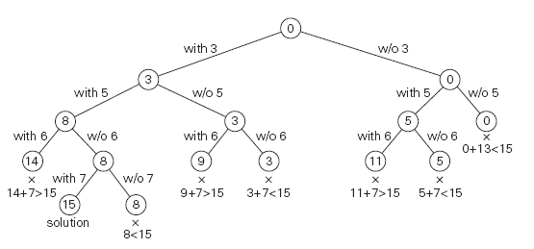
Subset problem

Slide 3
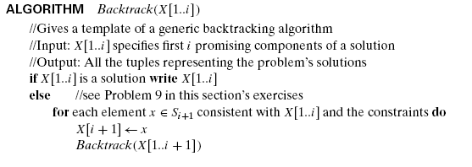
Sub set sum Algo

Slide 4
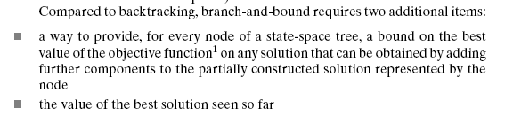
Branch and Bound

Slide 5
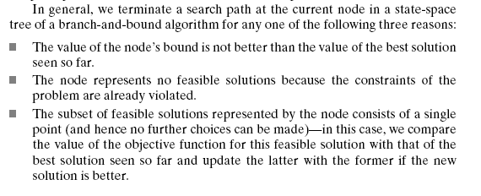
Branch and bound

Slide 6
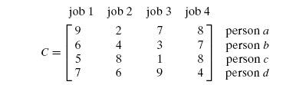
Assignment problem

Slide 7
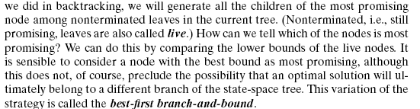
Assignment problem

Slide 8
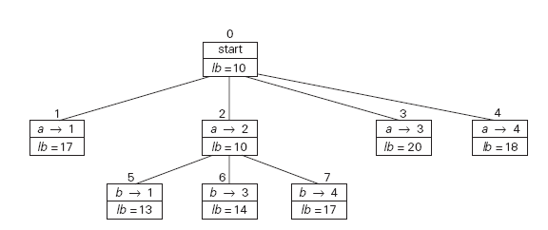
Exmaple

Slide 9
Thank You !!!

